Slide 1
EE2211 Python Tutorial II
Xingyi Yang
xyang@u.nus.edu
Aug 20 2024
Notes:
Because for most of the time, talking about programming language is boring. I would like to bring some fun facts about python during this course. You may type your questions in the chat box anytime during the tutorial. You can also share your screen to ask for my help on programming part.

Slide 2
10 min
10 min x 4
10 min
Introduction
keywords
& operators
data structures
numpy
example
Q&A

Slide 3
What questions has been posted?

Slide 4
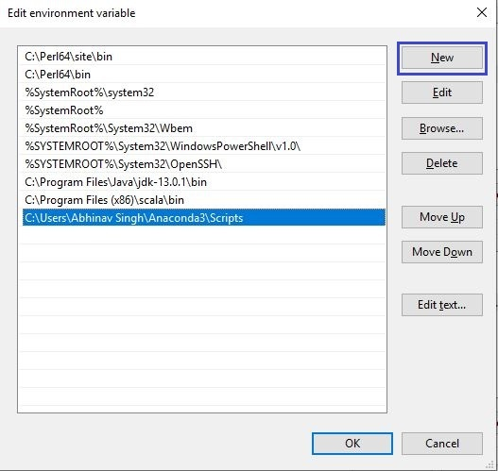
Q1 Can IDLE/Spyder/Jupyter/… be used instead of VScode?
A1 YES, as long as you get the correct configuration.
Q2 I cannot enter my environment on Windows😭!
A2 Add anaconda to the system PATH variable
https://www.geeksforgeeks.org/how-to-setup-anaconda-path-to-environment-variable/

Slide 5
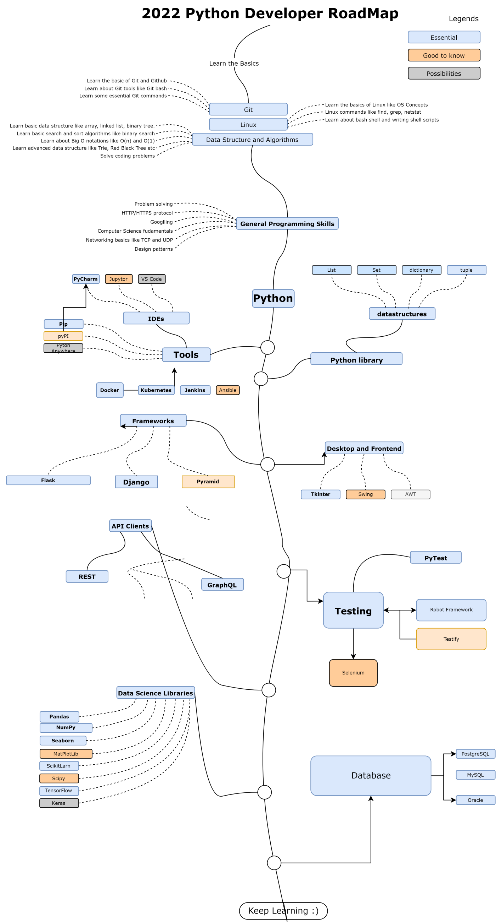
What I want to mention
Python is so big !!!!!
Notes:
Recommended to use Vscode. Very light weight and extensibility.

Slide 6
Notes:
Recommended to use Vscode. Very light weight and extensibility.

Slide 7
Notes:
Recommended to use Vscode. Very light weight and extensibility.

Slide 8
We cannot cover everything within one tutorial
We are not real programming language class
NO recursion
NO function/class/object/Inherence/reference
What we can do is quickly go through the concepts.
Give you overall impression of Python, or what is a programming language

Slide 9
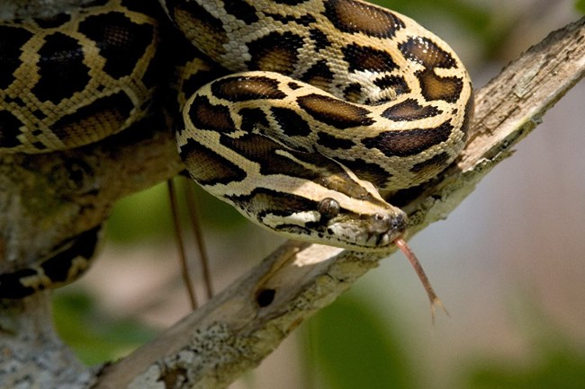
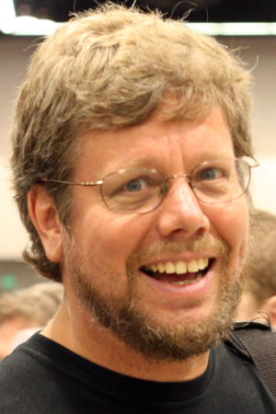
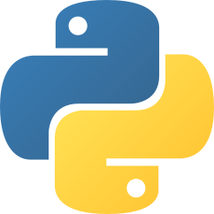
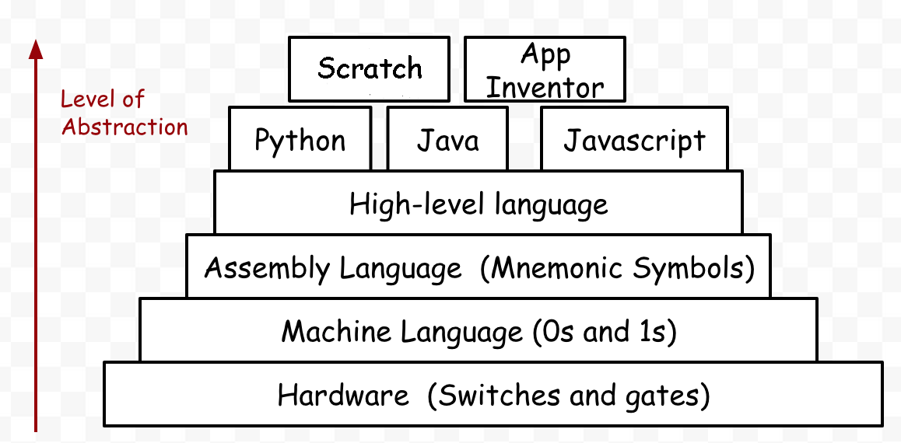
Python was conceived in the late 1980s by Guido van Rossum from Nederland
The programming language's name 'Python' came from a BBC Comedy series in the 1970's named Monty Python's Flying Circus. The author thought he needed a name that was short, unique and slightly mysterious.
Short and Simple

